Slide 1
Empower & engage
#Technologyandwomenmeet

Slide 2
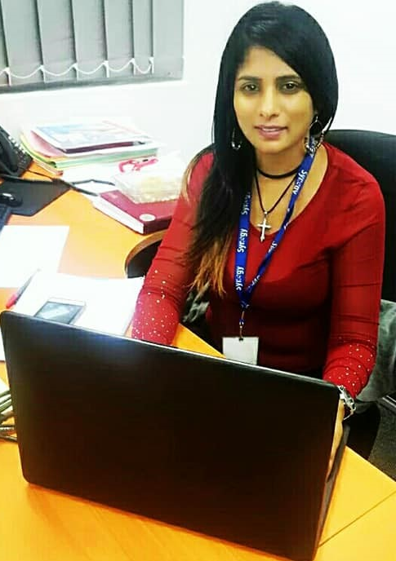
Digital Pink
An alliance for women & girls in Technology
By Valerie Naidoo

Slide 3
Advancing women in the digital space
An introductory guide to women and girls looking to become digitally literate in emerging and developing markets.

Slide 4
What is digital literacy?
Digital literacy is the ability to identify and use technology confidently, creatively and critically to meet the demands and challenges of living, learning and working.
Digital literacy encompasses a wide range of technologies such as mobile devices, computers, machines, software programs including social networking platforms.
It allows interactions and communications, creation and innovation through digital technologies.

Slide 5
Importance of digital literacy for women
We are living in the Digital age and Digital literacy is transforming the world and people economically, socially, professionally & personally too.
The Gender Technology divide between men and women is too wide, however the Gap can be minimized but more women need to start participating.
Digital skills for women is imperative in the current labor market – the entire economy is shifting and women need to step up to be able to access the high earning jobs/ contracts.
To raise the standard of living from breadline to average there needs to be an upgrade of digital skills.

Slide 6
barriers
Barriers especially for women in emerging and developing economies do unfortunately exist on many levels and hinder growth, economic empowerment etc.
Examples of some of these barriers are as follows:
Cultural Barrier – A woman’s place is at home
Affordability issue – lack the resources/finances to pursue a career in ICT
Mobility constraints
Fear Factor

Slide 7
Steps to boost women’s digital power when there’s a cultural barrier
Cultural barrier - Many cultures push us back – a woman’s place is at home.
Some hail from cultures where more opportunities are given to men. Hence not enough is done socially to encourage women to get into technology fields.
While structural issues are not an overnight fix, especially for women from the sub-continent or the Middle Eastern countries however small steps can be taken towards reducing this barrier.
A qualification in Technology such as web designing or coding is enough to empower any woman.

Slide 8
Overcome
Knowledge is power and having the relevant qualification positions an individual to work on her terms.
Women can do contract work or run a business such as web designing and this can be done remotely.
Working remotely will not take her away from the house or her family or her house hold duties and at the same time this individual will be contributing to economic empowerment.
It also positions a woman to contribute financially towards her home, hence raiskng the standard of living.
Don’t allow prescribed social norms to hold you back.

Slide 9
Steps to boost women’s digital power when there’s a Mobility constraint
Mobility constraints prevent people especially women from travelling outside school/working hours to attend ICT training/classes.
No transport to get to training/classes.
No childcare.

Slide 10
Overcome
Mobile & digital technologies allow women on some levels to bypass cultural and mobility issues such a smart phone or Tablet.
Access to online resources can help women access technology and develop their digital skills.
Online classes/training is offered by many institutes and there are also online/social media support groups that can be most useful.

Slide 11
Steps to boost women’s digital power when there’s an Affordability issue
Affordability issue – Digital courses can be expensive and some individuals are not able to afford this.
Some might have no financial support or even lack of resources to pursue a career in ICT

Slide 12
overcome
There are a few ways in which this barrier can be overcome:
Explore benefit entitlements for on low income groups.
Check for funds or grants to study/sponsors for digital resources.
Attend complimentary - digital skills sessions such as a one day taster course.
www.Alison.com offers Digital courses for free and you get an accreditation provided you pass the exams.
Many support groups are available online/social media.

Slide 13
Steps to boost women’s digital power to reduce the Fear factor
Technophobic – is the fear of technology and sadly some women have this phobia towards the digital world.
Additionally, people are either born with an aptitude for technology or not – this is a myth.
Some women unfortunately display limiting beliefs- hence self sabotaging behavior that stems from a fear of venturing into the unknown.

Slide 14
overcome
Success depends on applying yourself and putting in the hours to learn a new skill. Any area that we consistently apply ourselves to will result in improvement and the same applies to the digital field.
Technophobia- stems from our belief system. There’s no need to fear technology; while many aspects of the tech world can be intimidating but we put up the biggest and strongest barrier- let’s apply some work to retuning our belief system.

Slide 15
Additional tips
Women need to take care in the digital space. Use techniques such as Tor network or virtual private network (VPN) that better protect women’s identities and location especially in repressive societies.
Whether you’re looking to study or do a start-up in the digital space, there are options that can help fund your project. Business schools can help, through scholarships and bursaries for your studies and companies such as Grants.gov (many others) provide grants for small businesses.
It boils down to having a clear picture of your goal, visualise it and believe that it will come to pass.

Slide 16
About Valerie
I found myself in a technology based role in the UK quite by accident. Having applied for one role after my interview I was offered the role as stats analyst for a telecommunications company where I managed the entire MIS suite and this soon led to joining the project management team that involved the migration of call centres to different parts of India.
I was most certainly intimidated by Technology but my desire to succeed outweighed my fears.
My advise – never doubt your abilities because we all have the power within us to become anything we want- it starts with you.

